Slide 1
Evergreen Insurance – Quoting Platform MVP Delivery Review & Stakeholder Demo
Presented by: Ajit Ranjan Sahu
Thursday, July 16, 2026

Slide 2
Delivery Goals and Outcomes
Goals:
Deliver the Evergreen Insurance website with all minimum viable product (MVP) capabilities completed.
Ensure the website is fully functional, with all navigation links operating seamlessly.
Provide users with the ability to receive a quote premium upon entering the required information and selecting Submit.
Make the website available to stakeholders for demonstration and review.
Outcomes:
The Evergreen Insurance quoting platform has been deployed to GitHub Pages and is ready for stakeholder review.
The website provides users with the ability to generate and view a premium quote upon request.
All six navigation links have been implemented, tested, and validated to provide a seamless user experience.
Eleven premium calculation test scenarios were executed, with a 100% pass rate.
For Internal Use only

Slide 3
What is Shipping
Shipping with MVP:
Quote generation
Premium Calculation
Premium Comparison
Site Navigation
CI/CD Pipeline
GitHub Page deployment
Features Deferred for Post MVP:
Vulnerability Scanning
Customer Activity Logging
Demo URL:
https://ajit5144.github.io/Evergreen-Quote-Capstone-Phase1/
For Internal Use only

Slide 4
Key Delivery Decisions
Testimonials:
Legal approval for the customer testimonials is still pending.
However, a decision was made by the sponsor to retain the testimonial section in order to present a more complete and balanced page layout for the demonstration.
The implementation was designed to allow the section to be removed easily, if required.
Compare Plans in Navigation Enhancement:
This was a late-stage request, and the initial plan was to introduce a work-in-progress page so the team could add the content after MVP delivery.
The technology team identified a potential risk to customer acquisition with that approach.
As a result, the team decided to implement the functionality using the existing Home page logic.
Because the Home page logic had already been tested, the implementation risk was considered minimal.
For Internal Use only

Slide 5
Risks and Injects
Risk | Impact | Mitigation
Vulnerability Scan Pending | Medium | Complete post-MVP
Logging Not Implemented | Medium | Complete post-MVP
Injects:
Inject 1: The Compare Plan navigation link and customer testimonials have been fully implemented and are now clearly visible in the experience.
Inject 2: Production issue investigated; additional telemetry and tracing were implemented to improve diagnosis and reduce recovery time.
Inject 3: The CI configuration was enhanced to ensure the missing data requested by Operations is now displayed.
All updates and supporting details have been captured in the project board for reference.
For Internal Use only

Slide 6
What I’d do differently next time
Build the CI pipeline alongside development, incorporating the necessary validations from the outset.
Add premium validation test cases and run them on every push, rather than deferring execution until the final push.
Design shared reusable components before page implementation.
Introduce vulnerability scanning earlier in the development lifecycle.
For Internal Use only

Slide 7
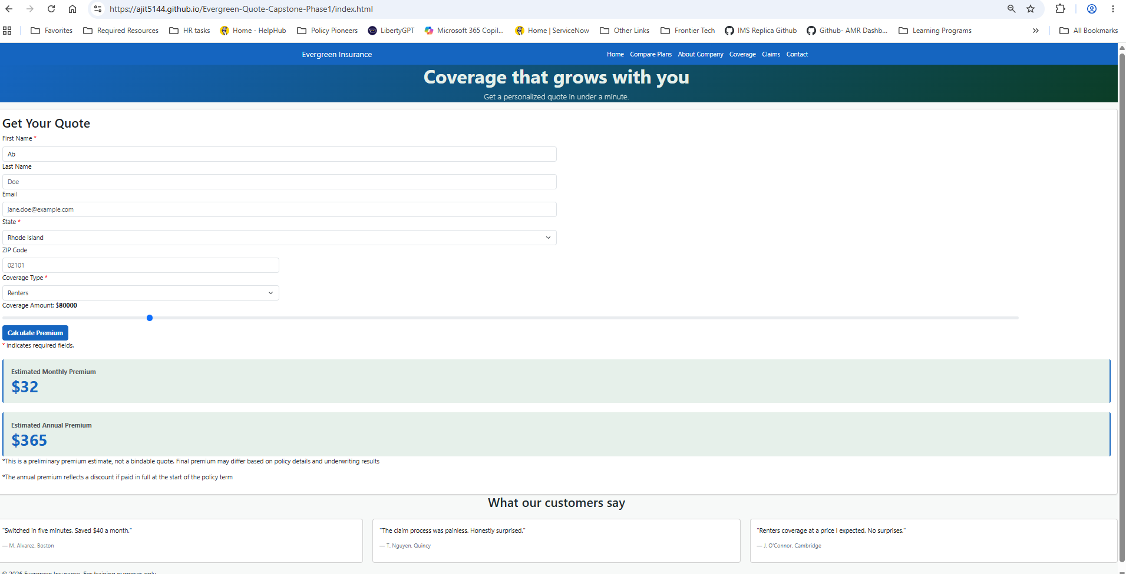
Sample Screenshot
For Internal Use only

Slide 8
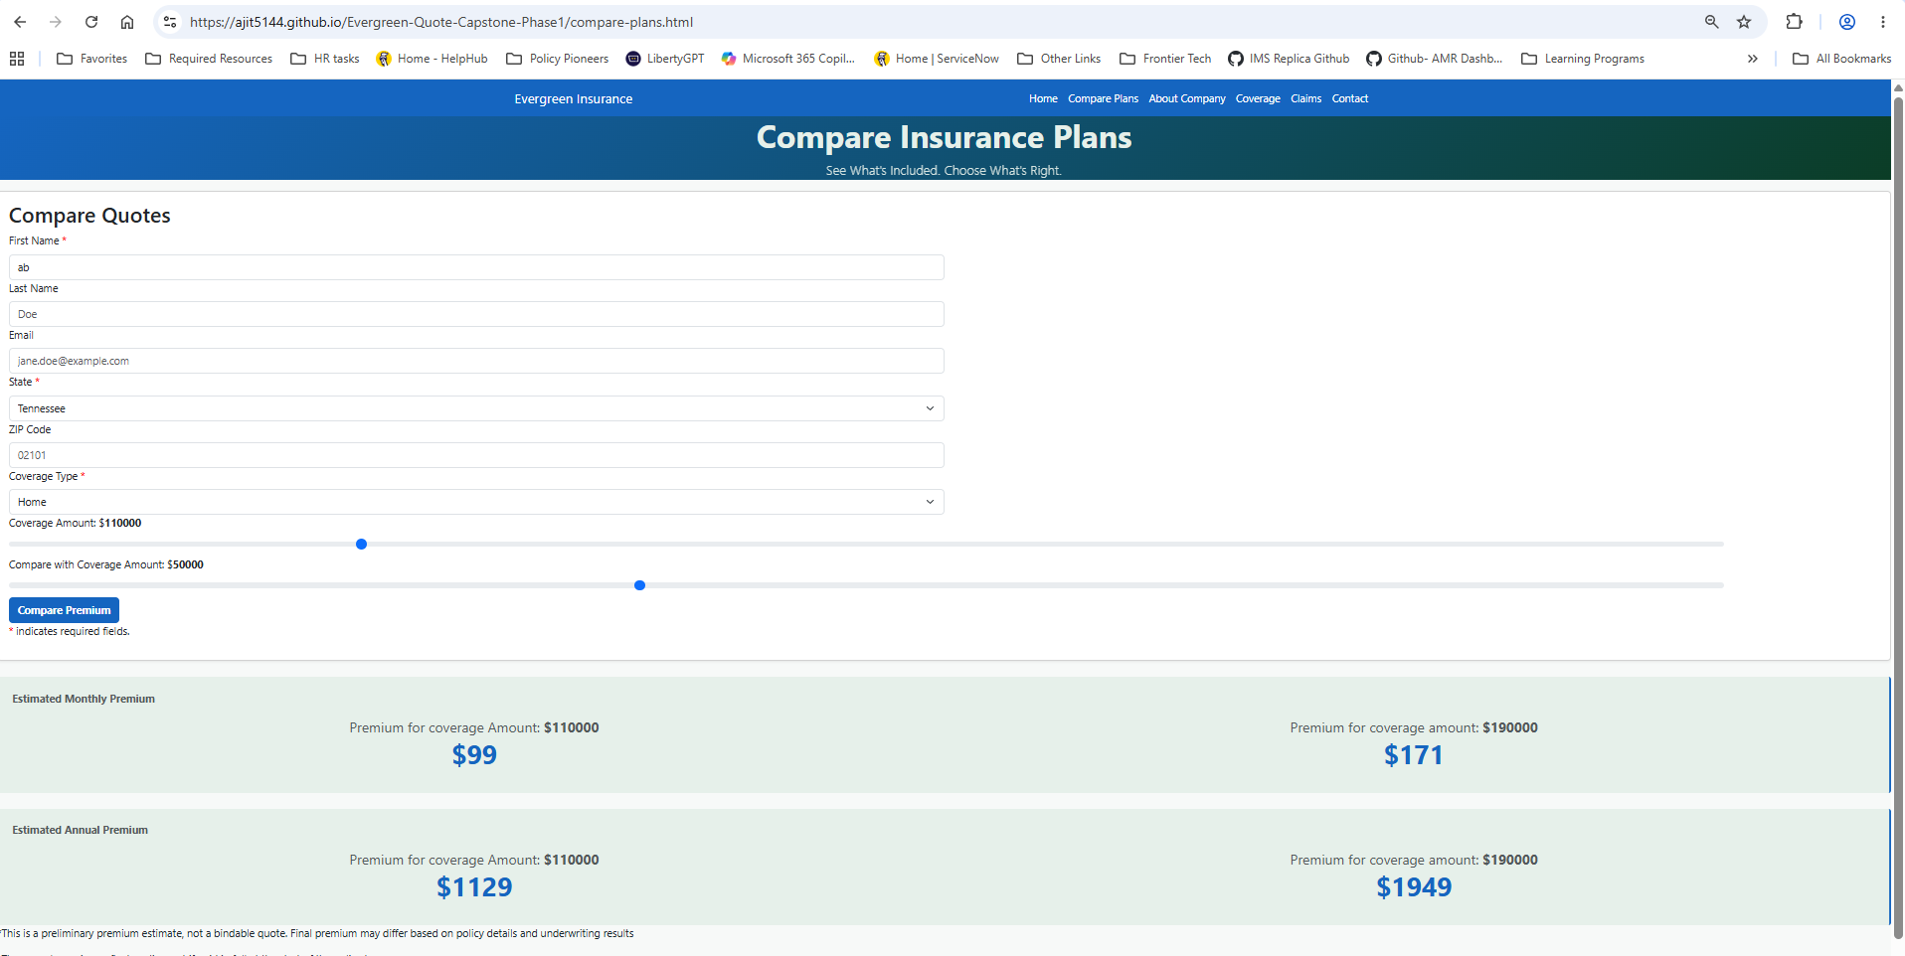
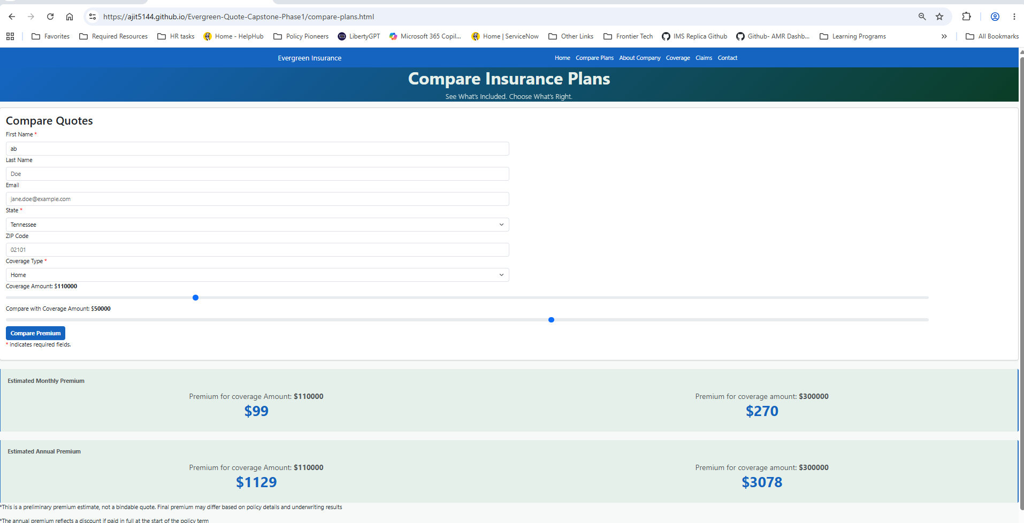
Sample Screenshot
For Internal Use only
For Internal Use only

Slide 9
Key Takeaways
MVP Delivered
GitHub Deployment Completed
Premium Quote Engine Operational
11 Test Scenarios Passed
Compare Plans Enhancement Delivered
Ready for Stakeholder Feedback
For Internal Use only

Slide 10
Q&A
For Internal Use only

